Slide 1
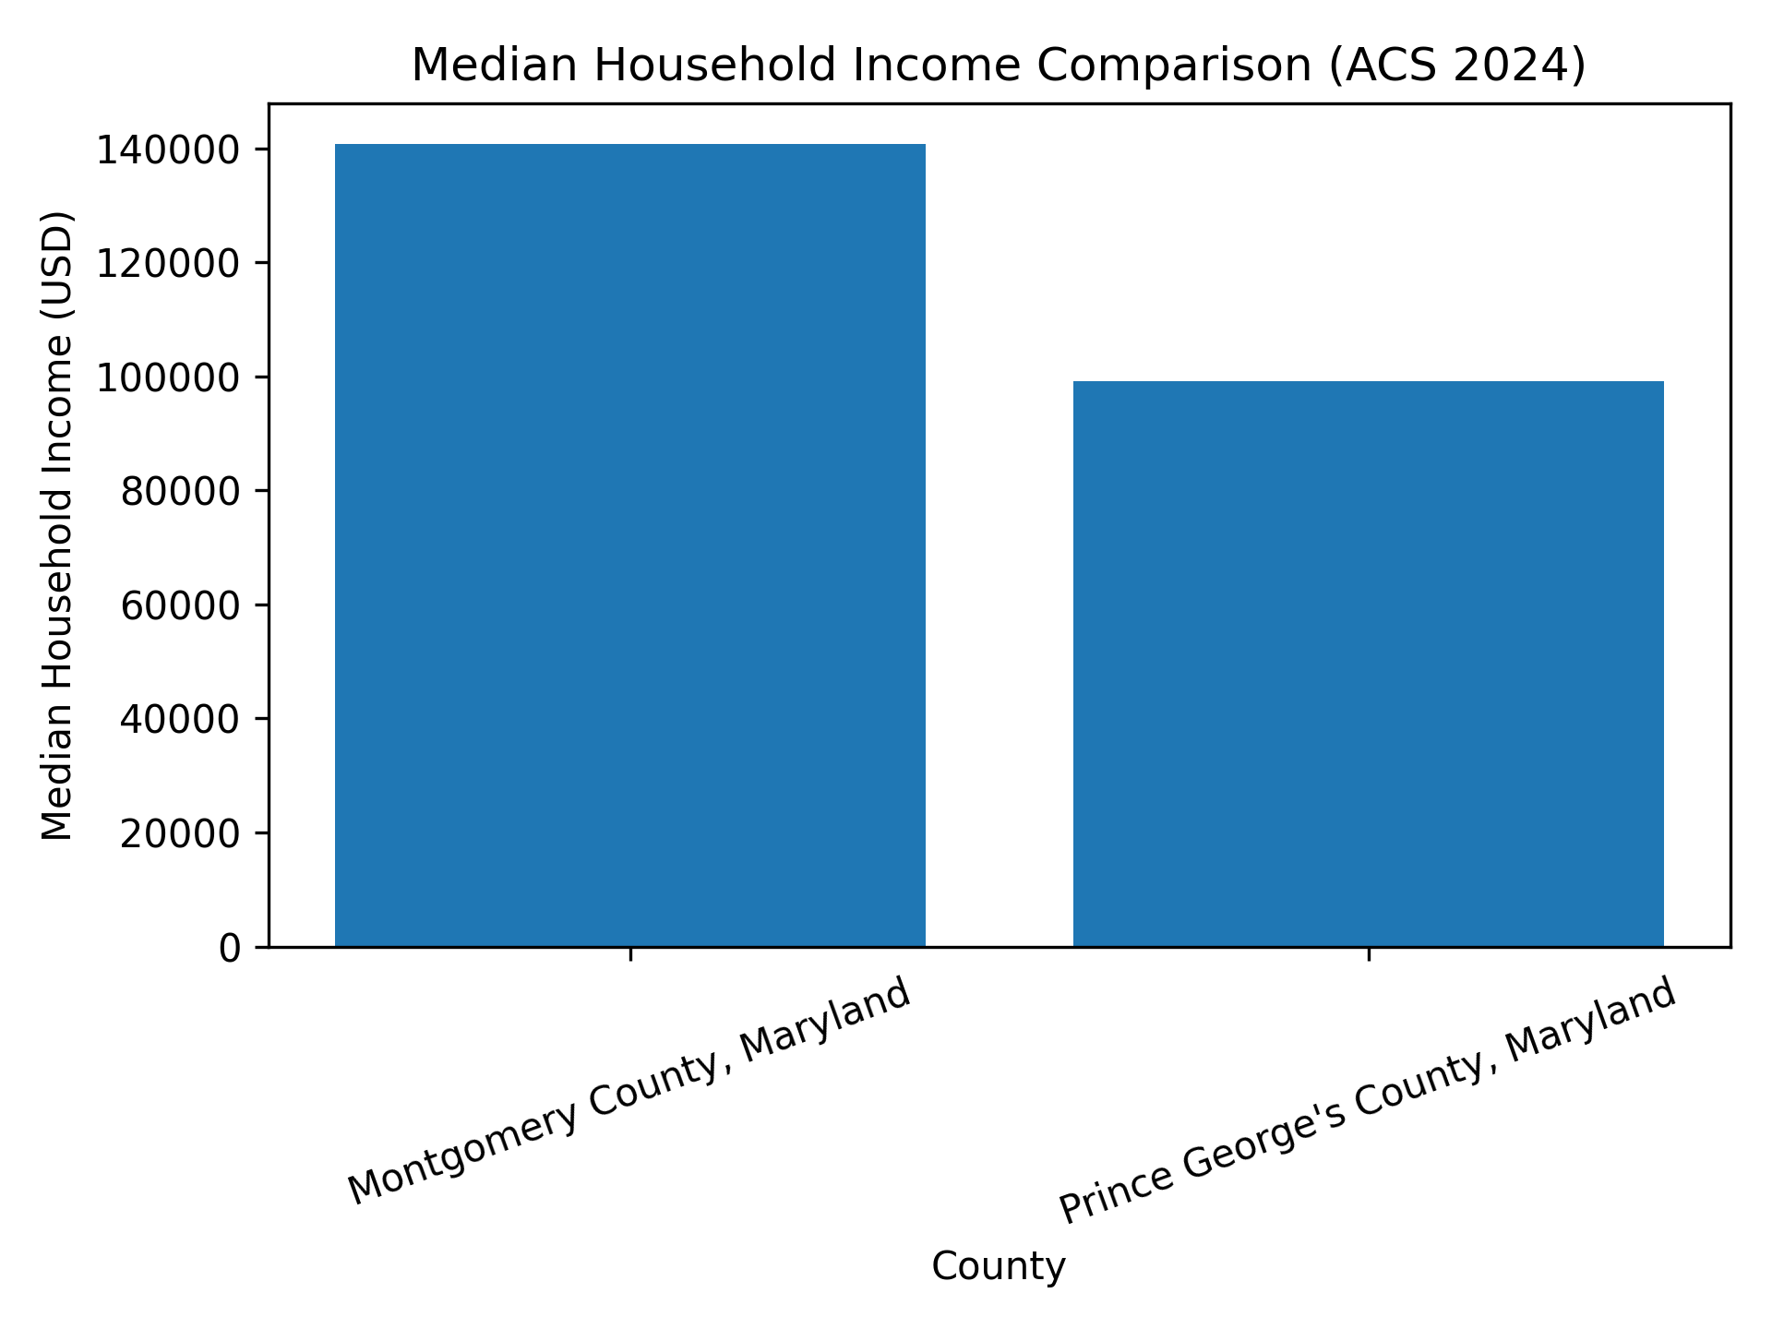
Visualization 1: Median Household Income (ACS 2024)

Slide 2
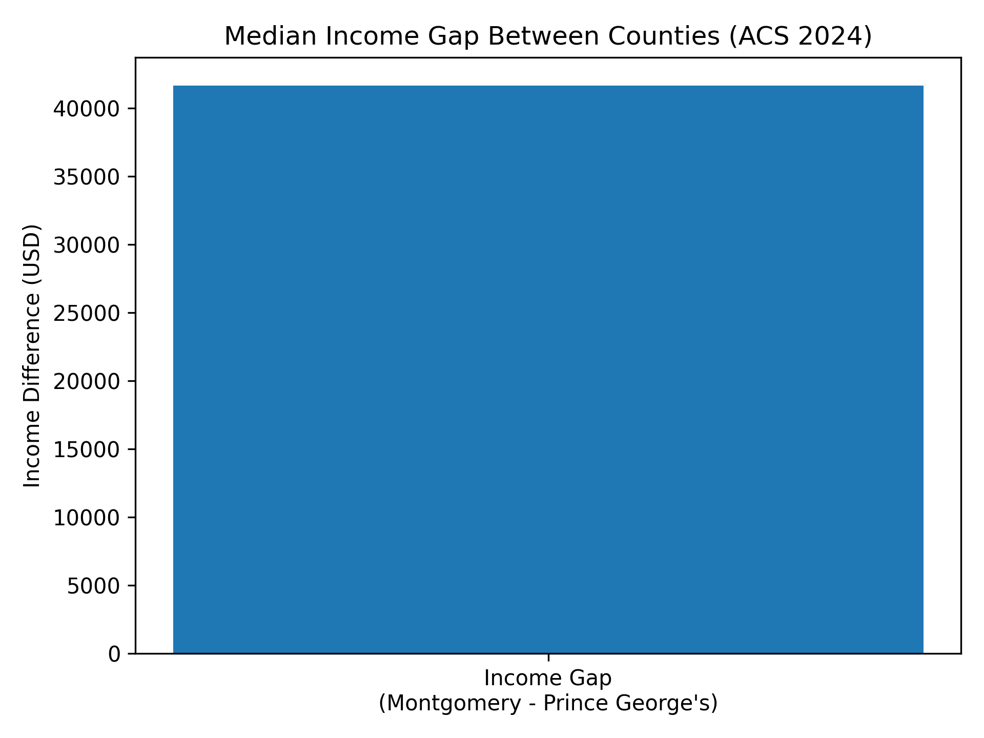
Visualization 2: Median Income Gap (ACS 2024)

